Slide 1
John 5A
(John 5:1-9)
A Feast of the Jews
(Statement of Facts)
Kit Sheehan

Slide 2
Introduction
Gospel of John is a “Spiritual Gospel”
Fabric of Scripture Pervades the Gospel
Teachers Provide Perspective
Previous Chapters Provide Background

Slide 3
Spiritual Gospel
Rather, "Early Church Father" is a title that gradually came to be applied to certain Christian leaders distinguished by four characteristics: antiquity, holiness, orthodoxy, and Church approval.
http://www.crossroadsinitiative.com/library_article/52/Early_Church_Fathers_Overview__Snapshot_of_the_Fathers_of_the_Church.html
Clement of Alexandria was a “Church Father”
[ca 150 AD – ca 215 AD]
“Clement wrote: ‘But that John, last of all, conscious that the outward facts had been set forth in the Gospels, was urged on by his disciples, and, divinely moved by the Spirit, composed a spiritual Gospel.’” from D. A. Carson, pp 27-28 [In Hypotyposes by Clement as quoted by Eusebius: Ecclesiastical History, Book. VII. VI. 14]
Gospel Portraits of Christ [D. J. Mock Vol III pg 24]:
  Matthew: Kingship/Promised Messiah King
  Mark: Redeemer/Suffering Servant of the Lord
  Luke: Humanity/Sinless Son of God
  John: Deity/Perfect Son of God
Read John 4:31-34 (Spiritual Food)
Application to Spiritual Walking in John 5

Slide 4

Fabric of Scripture
“The fundamentally Jewish and Old Testament background to John’s Gospel is increasingly recognized. What we call the Old Testament is what he repeatedly quotes, and that to which he repeatedly and explicitly alludes (e.g. with references to the tabernacle, Jacob’s ladder, Jacob’s well, manna, Sabbath and so forth).” D. A. Carson pp 59-60
There are many Johannine themes running through the gospel that tie it to the Old Testament:
  The New Moses
  The Temple
  The Seven Signs
  Life vs Death, Light vs Darkness, Truth vs Lies
  Divine Nature of the Messiah
  Jewish Leaders versus Jesus
  Glory
This study emphasizes John’s dependencies
on the book of Deuteronomy

Slide 5
John 5 Connections
Genesis
Gen 15
Psalms Ps92
John 5
John 5
Synoptic
Gospels
“John the Baptist”
Exodus
Commandments
Moses
John 5
John 1
John 3
Gospel to
Nicodemus
Leviticus
John 9
Healing of
Blind Man
John
13-19
Deuteronomy
“38 years”
Festivals
Commandments
Law of Witnesses
Isaiah
Jeremiah
Attack by the Priesthood
Who is
Jesus

Slide 6
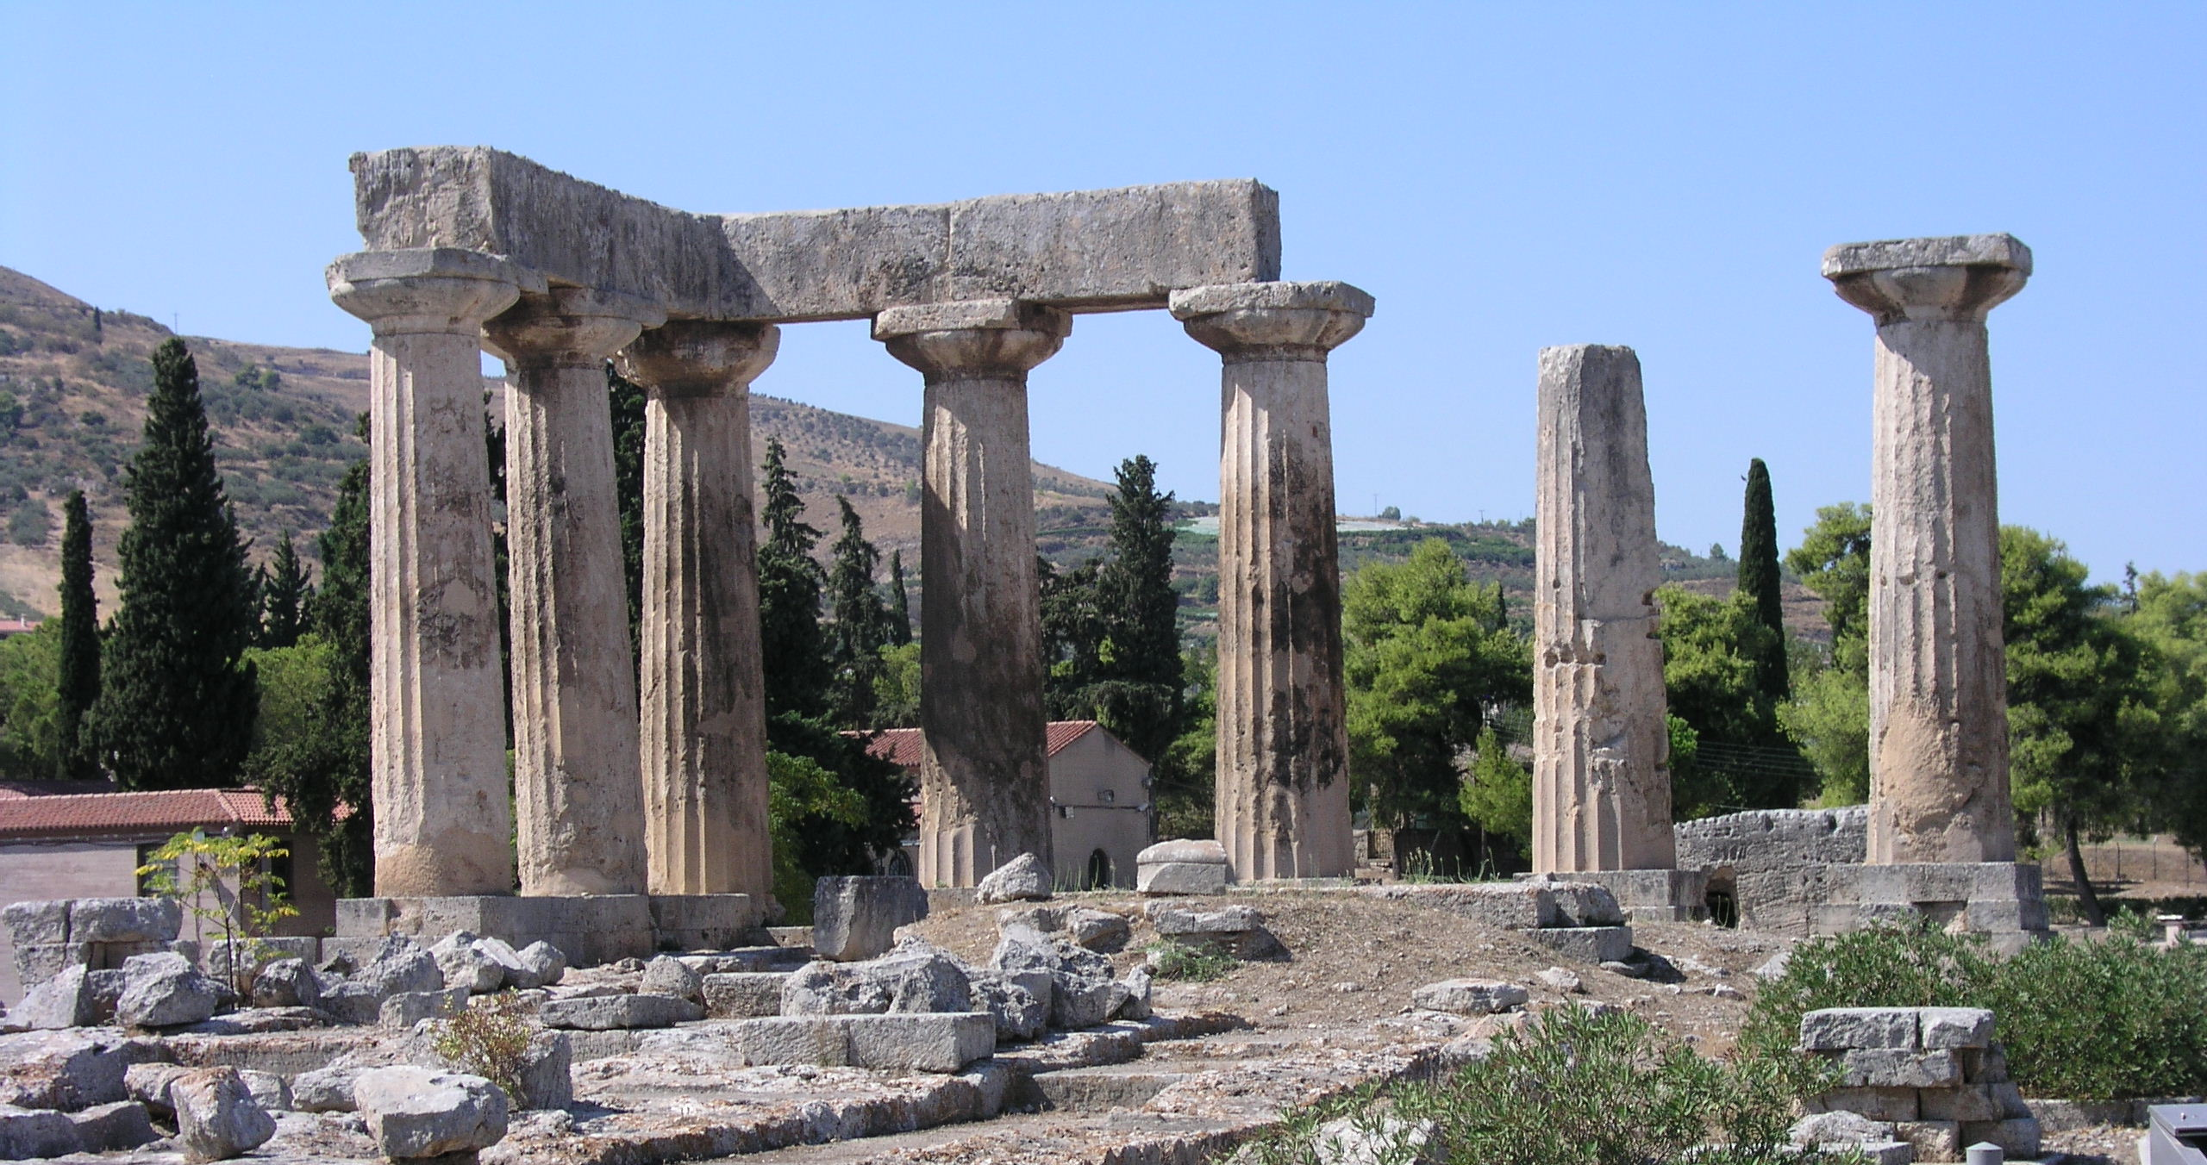
Different Perspectives
Gen 15:6 “Then he believed in the Lord; and He reckoned it to him as righteousness.”
Rom 4:1-5
James 2:14-26
Jn 6:29
1Jn 3:23
Jn 13:34
What is behind these
columns?
There is a building behind
these columns.

Slide 7
Gospel of John Outline
The Prologue (1:1-18)
The Book of Signs (1:19-12:50)
  …
  The Festival Cycle (5:1- 10:42)
    Ch5: Feasts of the Jews (5:1); Sabbath (5:9)
    Ch6: Feast of Passover (6:4)
    Ch7-8: Feast of Booths/Tabernacles (7:2)
    Ch9: Sabbath (9:14)
    Ch10: Feast of Dedication (10:22)
  …
The Book of Glory (13:1 – 20:31)
The Epilogue (21:1-25)
After Raymond Brown &
Andreas Kostenberger

Slide 8

Trial of John 5
Statement of Facts vs 1-15
Statement of Charges vs 16-18
Statement of Defense vs 19-31
Statements of Witnesses vs 32- 40
Statement of Counter Suit 41-47

Slide 9

Outline of John 5:1-9
Statement of Time/Date (vs 1)
Statement of Location (vs 2)
Description of the Scene (vs 3-5)
Description of Actions (vs 6-8)
Statement of Result (vs 9A)
Uh Oh! Addendum to Time/Date (vs 9B)

Slide 10
John 5:1-4
¹ After these things there was a feast of the Jews, and Jesus went up to Jerusalem.
² Now there is in Jerusalem by the sheep gate a pool, which is called in Hebrew Bethesda, having five porticoes.
³ In these lay a multitude of those who were sick, blind, lame, and withered,
[waiting for the moving of the waters; ⁴ for an angel of the Lord went down at certain seasons into the pool and stirred up the water; whoever then first, after the stirring up of the water, stepped in was made well from whatever disease with which he was afflicted.]

Slide 11
John 5:5-9
⁵ A man was there who had been ill for thirty-eight years.
⁶ When Jesus saw him lying there, and knew that he had already been a long time in that condition, He *said to him, “Do you wish to get well?”
⁷ The sick man answered Him, “Sir, I have no man to put me into the pool when the water is stirred up, but while I am coming, another steps down before me.”
⁸ Jesus *said to him, “Get up, pick up your pallet and walk.”
⁹ Immediately the man became well, and picked up his pallet and began to walk. Now it was the Sabbath on that day.

Slide 12
After these things
It is a frequent chronologic marker in John (Keener, Vol I, p635)
  3:22; 5:14; 6:1; 7:1; 19:38; 21:1; cf 13:7
It is a transition device
  It is a means of breaking with previous narrative
  It is at the same time referring back
So to what is it referring back?
  Previous Events

Slide 13
Note Some Previous Events
DETOUR
Chapter 2: Mary asked Jesus to supply wine
Chapter 3: Nicodemus Came to Jesus
Chapter 4: Samaritan Woman asked Jesus for the living water
Chapter 4: The Royal Official pleaded with Jesus for his son’s healing
Here Jesus goes out of His way to select the lame man…a man who did not ask to be healed

Slide 14
Chapter 2
Wedding Feast
  2:3 When the wine ran out, the mother of Jesus said to Him, “They have no wine.”
  2:11 This beginning of His signs Jesus did in Cana of Galilee, and manifested His glory, and His disciples believed in Him.
Temple Cleansing
  2:16 and to those who were selling the doves He said, “Take these things away; stop making My Father’s house a place of business.”
  2:17 His disciples remembered that it was written, “Zeal for Your house will consume Me.”
  2:19 Jesus answered them, “Destroy this temple, and in three days I will raise it up.”
  2:22 So when He was raised from the dead, His disciples remembered that He said this; and they believed the Scripture and the word which Jesus had spoken.

Slide 15
Chapter 3
Nicodemus
  3:2 this man came to Jesus by night and said to Him, “Rabbi, we know that You have come from God as a teacher; for no one can do these signs that You do unless God is with him.”
  3:18 “He who believes in Him is not judged; he who does not believe has been judged already, because he has not believed in the name of the only begotten Son of God.”
John the Baptizer
  3:26 And they came to John and said to him, “Rabbi, He who was with you beyond the Jordan, to whom you have testified, behold, He is baptizing and all are coming to Him.”
  3:30 “He must increase, but I must decrease.”
  3:36 “He who believes in the Son has eternal life; but he who does not obey the Son will not see life, but the wrath of God abides on him.”
  Note: Reference to John the Baptist infers the reader is already familiar with the life of John the Baptist.
!

Slide 16
Chapter 4
Samaritan Woman
¹⁵ The woman *said to Him, “Sir, give me this water, so I will not be thirsty nor come all the way here to draw.”
³⁹ From that city many of the Samaritans believed in Him because of the word of the woman who testified, “He told me all the things that I have done.” ⁴⁰ So when the Samaritans came to Jesus, they were asking Him to stay with them; and He stayed there two days. ⁴¹ Many more believed because of His word; ⁴² and they were saying to the woman, “It is no longer because of what you said that we believe, for we have heard for ourselves and know that this One is indeed the Savior of the world.”

Slide 17
Chapter 4
⁴⁷ When he heard that Jesus had come out of Judea into Galilee, he went to Him and was imploring Him to come down and heal his son; for he was at the point of death.
49 So Jesus said to him, “Unless you people see signs and wonders, you simply will not believe.”
⁴⁹ The royal official *said to Him, “Sir, come down before my child dies.”
⁵⁰Jesus said to him, “Go; your son lives.” The man believed the word that Jesus spoke to him and started off.

Slide 18

Side Note
“The Greek word for ‘royal official’, basilikos, sometimes rendered ‘nobleman’, probably refers to someone officially attached to the service of a basileus, a ‘king’ – here doubtless referring to Herod Antipas. He was tetrarch of Galilee from 4BC to AD 39, and not properly a ‘king’ at all; but he was popularly considered one (Mk 6:14). [Carson p238]
Is it not probable that Herod Antipas, the man who later wanted to see Jesus (Lk 23:8) heard about an official under his authority who was impacted by a miracle performed by Jesus.
Interestingly, Malkus, later at Jesus’ arrest, is healed after Peter cuts off his ear. Malkus was Caiaphus’ slave.
Both Herod & Caiaphas conducted trials of Jesus. Both have people in their employ impacted directly by Jesus.
Interesting

Slide 19
Jesus’ Public Ministry
Based on comparisons with the Synoptics, Jesus started His public ministry in Galilee at around the time of John Chapter 5
Contemporaneous with the death of John the Baptist
Chronological Note
  John 3 occurred prior to John the Baptist’s arrest
  John 4 occurred just after John the Baptist’s arrest
  John 5 occurred close to John the Baptist’s death
  John 6 occurred after John the Baptist’s death

Slide 20
Timeline of Jesus’ Ministry
He departed from
Galilee (Matt 19:1
See also Mk 10:1)
Judea
Galilee Ministry
Judea
He departed into
Galilee (Matt 4:12
See also Mk 1:14;
Lk 4:14))
But He answered and said,
“I was sent only to the
lost sheep of the house of Israel.”
Matt 15:24

Slide 21
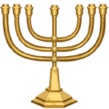
Which Feast?
“John repeatedly ties his narrative to various Jewish feasts: cf 2:13 (Passover); 6:4 (Passover); 7:2 (Tabernacles); 10:22 (Dedication); 11:55 (Passover). This is the only one that is not identified more precisely.”
“The truth of the matter is that we do not know what feast John has in mind. If the other feasts are named, it is because the context in each case finds Jesus doing or saying something that picks up a theme related to it. By implication, if the feast in John 5 is not named, it is probably because the material in John 5 is not meant to be thematically related to it.”
Carson, pp 240-241
Observation: “…there was a feast of the Jews” There is no definite article.
“Jews were obliged to go to Jerusalem at the three major feasts of Passover, Pentecost, and Tabernacles, …” Brown, V1 p206

Slide 22

Hermeneutical Comments
Economy of Words
  John doesn’t just throw words into his narrative – every word is important and in the text for a reason. Every word!
  “There is not a line in the Bible which is placed there for mere rhetorical effect, or for the gratification of curiosity.” D.G. Barnhouse p17
  “The structure of the Fourth Gospel reveals that it is one of the most carefully crafted pieces of literature in the Bible.” Stephen S. Kim (Bibliotheca Sacra 165, October-December 2008) 413-24)
New Testament is Built on the Old (The Fiber of Scripture)
  John is constantly referring to the Old Testament, often obliquely, demanding that you know your Scripture. The Jews did!
You must ask the right question:
  The right question is not which feast this is. Most commentators go that route and find nothing definitive.
  The right question is “What do these feasts have in common?”
  Implicit in this question is a second “Where in the Bible are they documented?”
So where do we learn about these feasts?
  Deuteronomy 16:16-17

Slide 23
Deut 6:16-17
“Three times in a year all your males shall appear before the Lord your God in the place which He chooses, at the Feast of Unleavened Bread and at the Feast of Weeks and at the Feast of Booths, and they shall not appear before the Lord empty-handed. Every man shall give as he is able, according to the blessing of the Lord your God which He has given you.”
These are sometimes called the pilgrimage feasts because the Jews traveled to Jerusalem to present themselves at the temple.
Something else to consider: in the “Festival Cycle” (Jn 5:1-10:42), this unnamed feast could be representative of all the feasts – what did they all have in common?
Like 2 Cor 8-9

Slide 24
Jesus “Went Up”
Among other uses, for going up to Jerusalem and the temple (Kittel V1, p519) for the Pilgrimage feasts
  Jn 2:13 (Passover)
  Jn 5:1 (a feast)
  Jn 7:10 (Tabernacles)
  Jn 11:55 (Passover)
Side Note: Went up or ascending to Jerusalem is a time when certain of the Psalms, called Psalms of Ascent are sung: Ps 120 - 134

Slide 25
John 5:2
Now there is in Jerusalem by the sheep gate a pool, which is called in Hebrew Bethesda, having five porticoes.
The Bethesda pool has been
found!
“gate” is not in the original text
Adjective: pertaining to sheep

Slide 26
Pool(s) at Bethesda
Sheep (Gate)
Antonia
Fortress
Temple
Mount
Kidron VAlley

Slide 27
What is a Portico?
Portico is a covered walkway
Portico is a colonnade
Five Porticoes has what shape?
  Pentagon?
  Star Shape?
  No!
Archeology discovered these porticoes!
A thing of Beauty

Slide 28
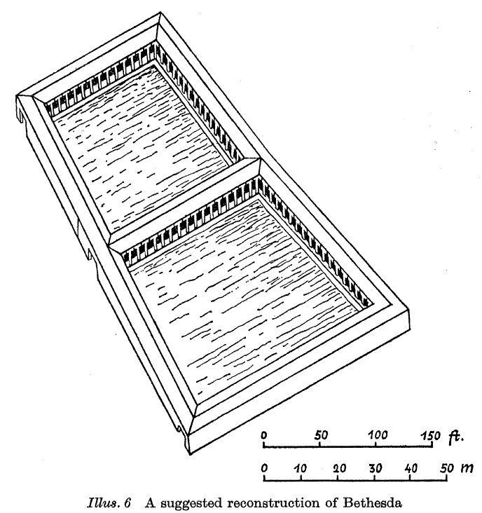
The Five Porticoes
From:
The Rediscovery of Bethesda
By Jeremias

Slide 29
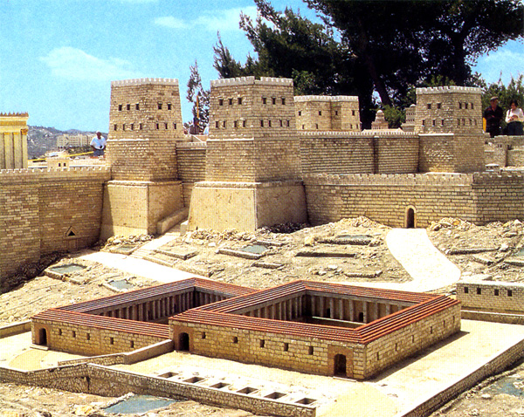
Bethesda Model
From:
http://emp.byui.edu/SATTERFIELDB/Rel211/jerusalem.htm
(photo of model at Holy Land Hotel, Jerusalem

Slide 30

Why Sick People?
“In these lay a multitude of those who were sick, blind, lame, and withered…”
Unable to care for themselves
Waiting for a miracle
Violating the Law –
  Possibly an “asclepeion” [a healing temple, sacred
  to the god Asclepius]
  Asclepius is the god of medicine and
  healing in ancient Greek religion
Praying “Oh, God…” prayers
Nursing Home Atmosphere
“Hopeless, Helpless, Useless”
Much like the spiritual condition of Judea in Jesus’ day

Slide 31
Johannine Ironic Contrast
Observe the Beautiful Porticoes
Smell the urine and excrement
Hear the cries of despair
Feel the Stress, Anxiety, Depression - Hopeless Situation
Atmosphere: “Experience the passage”

Slide 32
When Jesus saw
Look at the reconstruction of the twin pools of Bethesda
  What do you notice (observation)?
  The people inside are sheltered from the weather
  The people on the outside are sheltered from noticing those on the inside
This means, Jesus had to make a conscious detour to go inside the porticos to seek out this man

Slide 33
Jesus’ Public Ministry Starts
Prior Events
  Chapter 2: Mary asks Jesus…
  Chapter 3: Nicodemus asks Jesus…
  Chapter 4: Samaritan woman asks Jesus
  Chapter 4: Royal Official asks Jesus
Chapter 5: Jesus asks the lame man…
  Jesus takes the offensive
  Jesus is going to the lost sheep of the house of Israel (Matt 15:24)
  He loves His people in spite of their rejection

Slide 34
Thirty Eight Years
Some commentators shy away from relating this to Deut 2:14
Two hermeneutical comments:
  John doesn’t just throw words into his narrative – every word is important and in the text for a reason (OK, this is a repeat – but it is important!)
  John is constantly referring to the Old Testament, often obliquely, demanding that you know your Scripture – the Jews did!
Question: Does this man represent the state of the Jews in Judea and Galilee? Jesus is seeking them out to heal them.
proxy for Israel

Slide 35
Deut 2:14, 25
2:14 – Now the time that it took for us to come from Kadesh-barnea until we crossed over the brook Zered was thirty-eight years, until all the generation of the men of war perished from within the camp, as the Lord had sworn to them.
2:25 – This day I will begin to put the dread and fear of you upon the people everywhere under the heavens, who, when they hear the report of you, shall tremble and be in anguish because of you

Slide 36
Was He a Believer?
The man was obviously a Jew
  Jesus was sent to the lost sheep of Israel (Matt 24:15)
  The man goes to the temple and converses with the priests
The stated issue is not salvation but walking
  Jesus tells him to sin no more – salvation is a point in time based upon faith in Jesus Christ, not a cessation of sinning
  The man is lame and cannot walk
  Walking is the believers life, from a spiritual perspective

Slide 37
Walking
Remember, Jesus speaks from a spiritual perspective
  In John 4, eating was doing the will of God the Father
  Here, the man is to return to a spiritual life
Points on Walking
  Walking in the NT depicts the Christian way of life.
  Rm 14:5-6; Eph 5:16; James 4:13-15
  Walking may also depict the life of the unbeliever and believer out of fellowship. Eph 4;17; Phil 3:18
  Three spheres of positive walk
    By Faith II Cor 5:7; Col 2:6
    In the spirit Gal 5:16
    In Doctrine III Jn 3

Slide 38
Spiritual Walking (John)
Jn 8:12
  Then Jesus again spoke to them, saying, “I am the Light of the world; he who follows Me will not walk in the darkness, but will have the Light of life.”
Jn 11:9-10
  Jesus answered, “Are there not twelve hours in the day? If anyone walks in the day, he does not stumble, because he sees the light of this world. ¹⁰ But if anyone walks in the night, he stumbles, because the light is not in him.”
Jn 12:35
  So Jesus said to them, “For a little while longer the Light is among you. Walk while you have the Light, so that darkness will not overtake you; he who walks in the darkness does not know where he goes.
Also 1Jn 1:7; 2Jn 4,6; 3Jn 3-4

Slide 39
Some Walking in Deuteronomy
Deut 5:33 You shall walk in all the way which the Lord your God has commanded you, that you may live and that it may be well with you, and that you may prolong your days in the land which you will possess.
Deut 8:6 Therefore, you shall keep the commandments of the Lord your God, to walk in His ways and to fear Him.
Deut 10:12-13 “Now, Israel, what does the Lord your God require from you, but to fear the Lord your God, to walk in all His ways and love Him, and to serve the Lord your God with all your heart and with all your soul, and to keep the Lord’s commandments and His statutes which I am commanding you today for your good?
Deut 11:22 For if you are careful to keep all this commandment which I am commanding you to do, to love the Lord your God, to walk in all His ways and hold fast to Him, ²³ then the Lord will drive out all these nations from before you, and you will dispossess nations greater and mightier than you.
Deut 13:4 You shall follow the Lord your God and fear Him; and you shall keep His commandments, listen to His voice, serve Him, and cling to Him.

Slide 40
I have no man
The man never asks Jesus for help
The man replies to Jesus’ offer of healing with human viewpoint – superstition
The man never thanks Jesus

Slide 41
Healing!
Get up
Did this man repent? Did this man “believe?”
Grace = not deserving
God’s will – man did not ask
God doesn’t punish us for sin. God is trying to get our attention so we turn back to Him by faith.
Sometimes, rather than cursing, God might bless us to get our attention!

Slide 42
Summary
Jesus sought out the Jewish man who could not and would not walk – kind of a proxy for the Jewish people at the time
He healed him such that he could accomplish a Jewish man’s responsibility under the Law to celebrate a Jewish feast, including not coming empty handed
He got the attention of the “Jews” which afforded Him the opportunity to give them gospel information.
He did this out of love:
  Love is observant
  Love sees a need
  Love responds to that need

